Slide 1
No Longer an Afterthought, Infusing Ethics Synergistically Into Courses
Notes:
Thank you for joining me today. Curiosity is a lifelong trait that drives engineers, and I’m glad to share with you what I’ve learned about (Subject). And please continue that curiosity by attending the additional WE20 sessions and events. But for now, let’s get started.

Slide 2
Overview
At the end of this session, you will be able to:
Recognize the goal of the Mozilla Foundation Computer Science Challenge
Identify ethical concepts that complement your course
Identify modifications that can be made to support infusing ethical concepts into your course

Slide 3

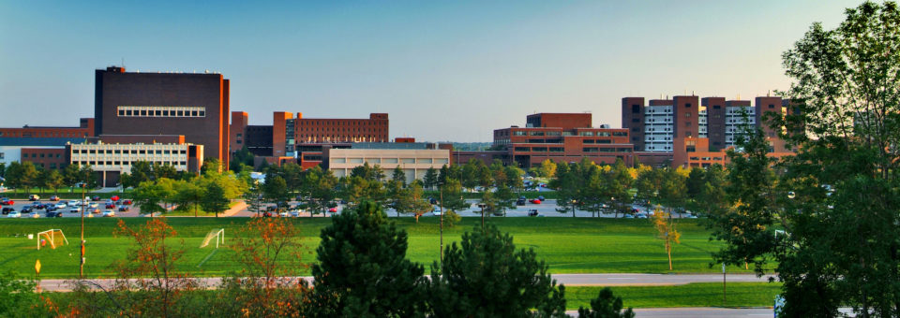



Jennifer Winikus, PhD
Assistant Professor of Teaching at the University at Buffalo
Why Ethics?
It’s important in Engineering Education
History is fascinating
Learning from History, Ethics really are important
FY21 LAB Chair

Slide 4
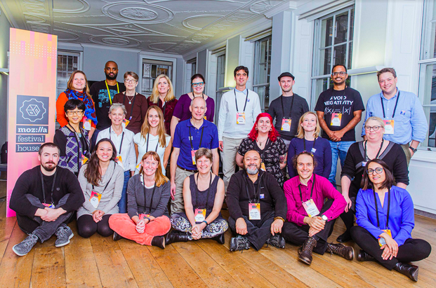
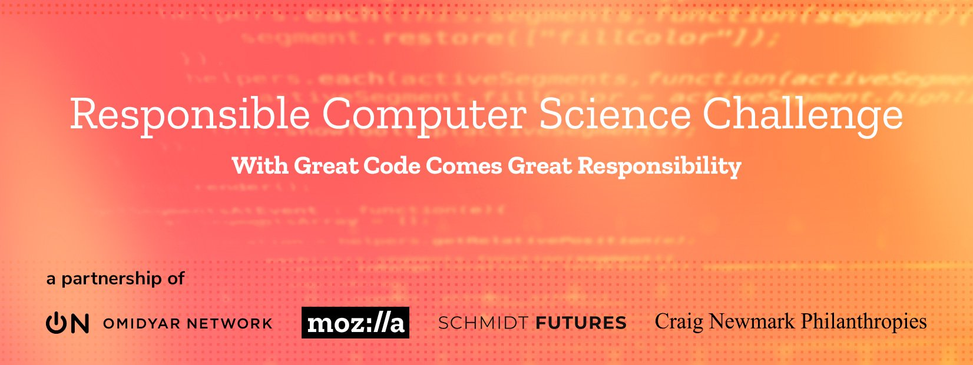
Mozilla Foundation Responsible Computer Science Challenge
“How can ethics be integrated into undergraduate computer science education in order to empower future technology builders to create a healthier internet for all?”
17 teams were selected to start to take on this challenge in Phase 1
https://foundation.mozilla.org/en/initiatives/responsible-cs/

Slide 5
Ethics in CS Education as a first principle and not an afterthought
8 faculty - A. Rudra, M. Hertz, V. Chandola, K. Joseph, J. Hartloff, S. Ko, J. Winikus, M. Bolton, and M. Shepard
Integrate Ethics into 4 undergraduate courses in the Department of Computer Science and Engineering
CSE199: Internet, Computing, and Society (600 students)
CSE331: Algorithms (150 Students)
CSE442: Software Engineering (150 Students)
CSE474: Machine Learning (150 Students)
Create a new course – Algorithms and Society

Slide 6
Our Approach

Slide 7
First - Consider the Course

Slide 8
You have a course in mind, now what? Pick one part of the class and answer these questions
What is the learning outcome you want to satisfy?
This should come from the syllabus
What skill(s) do you want as an outcome?
Consider accreditation requirements and industry advice
What experience(s) do you want the participants to have?
How do you want the participant to approach this outcome
– Such as lecture, active learning or experiential learning
What aspect of the course do you want to focus on?
What content topic?
Pick how will you evaluate satisfying the outcome?
By delivering the information? Assessment?

Slide 9
Assessments
Formative
Low stakes, evaluate over a continuum
Summative
High stakes, evaluation at points of time
Activities
Discussions
Think Pair Share
Surveys
Reflections
Homework
Labs
Quizzes
Exams
Projects
Presentations
Reports

Slide 10
Then the Ethics Component

Slide 11
Approach for Integrating Ethics
Identify a code of ethics
Most professional societies have codes of ethics
Choose one that relates to the discipline of the course
Identify a piece of the code
Describe that piece of the code as a learning objective related to your course
Recommend using Bloom’s Taxonomy
Modify the experience/assessment to also satisfy the ethical learning objective
Rewording, choosing different examples/scenarios, expanding aspects of assessment

Slide 12
An Example

Slide 13
CSE199: Internet, Computing, and Society
First year seminar
Mostly computer science and computer engineering students, but is open to all majors
Fall 2019 – Approximately 600 students
Fall 2020 – 739 students participating online
Part of the UB Curriculum – the approach to the general education requirements

Slide 14
The first set of questions
What is the learning outcome you want to satisfy
Students will be able to recognize and debate ethical issues and academic integrity in a variety of settings. (UB Curriculum)
What skill(s) do you want as an outcome
Communication and critical thinking
What experiences do you want the participants to have
Experiential, active, and collaborative
What aspect of the course to focus on?
Gamification and technology evolution

Slide 15
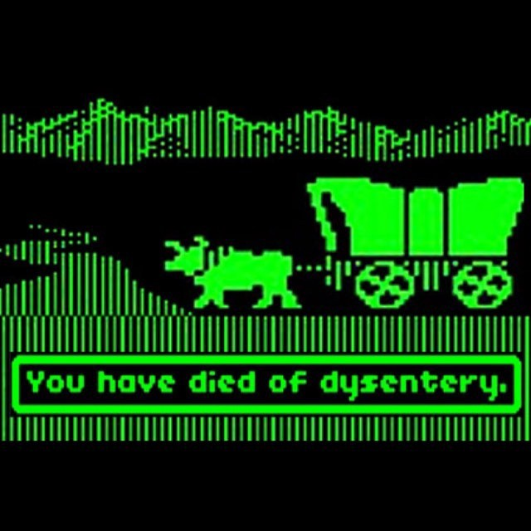
The Assessment – Considers Course Content
Assessment/Delivery: Formative
Content: Recognize ethical issues around accessibility and education, understand evolution of technology
The Activity: Play “Oregon Trail”
In small groups
First the 1990 edition
Then the 1993 edition
Consider the evolution of usability
Does it meet the game objective “to teach 8th grade school children the realities of 19th-century pioneer life on the Oregon Trail”
https://en.wikipedia.org/wiki/The_Oregon_Trail_(series) https://noproscenium.com/nyc-ghost-town-on-the-oregon-trail-663e343e49de

Slide 16
A Code – IEEE Code of Ethics
2. to improve the understanding by individuals and society of the capabilities and societal implications of conventional and emerging technologies, including intelligent systems;
Why?
Emerging technologies is something that relates to looking at different versions of programs
The game was intended to have implications in society through it’s use in education
https://www.ieee.org/about/corporate/governance/p7-8.html

Slide 17
A new learning outcome
Bloom’s Taxonomy
Develop the outcome
Create
Evaluate
Analyze
Apply
Understand
Remember
Pick a level – “Remember”
Pick a verb from that level – “Describe”
Form the learning outcome statement:
Students will be able to describe the societal impact from the advances of usability between versions.

Slide 18
Modify – Add questions to the activity (Fall 2020 Questions) Fall 2019 was similar but too many questions
While playing the 1990 version
Are there any aspects that are not accessibility compatible? What aspects?
Identify 3 benefits of using this as a teaching tool in elementary/primary schools
While playing the 1993 version
Are there any aspects that are not accessibility compatible? What aspects?
Identify 3 usability/interaction “upgrades” for this version, for each also state where outside the game (IRL) the upgrade would create a positive impact
Closing Discussion
If there were accessibility issues in the 1993 version, come up with one idea to address it
Consider current technology, what do you think would be the best new upgrade to add in?
What did you learn about the Oregon Trail? Does that satisfy the learning objective the game was developed for? Why or why not?

Slide 19
Did it work?
Fall 2019
Students had a good time and thought about societal impacts
It worked!
Fall 2020
Was the first group activity – supported working out technology issues
Added teambuilding effect in the small groups

Slide 20
Now What?
At UB
Continue using what was developed in 2019 and expand to more concepts and courses
Collaborate with other disciplines on projects uniting multiple courses
Submit for stage 2
For the Responsible CS Challenge
Stage 2 applications due March 2021
Dissemination of lessons learned and tools for others to embed ethics in their courses
For you
Consider where you can modify things to include ethics using our approach
https://foundation.mozilla.org/en/initiatives/responsible-cs/

Slide 21
Want to know more? Email jwinikus@buffalo.edu

Slide 22
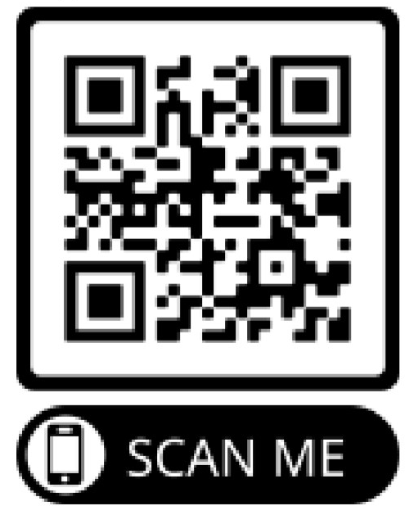
Thank you Please take the WE20 Session Survey
Notes:
Thank you for joining me in my presentation today. I hope you found it interesting and useful. And while circumstances may have caused a completely virtual WE20. I look forward to a time when we all can meet safely in person. Until then be safe, stay healthy and practice curiosity.

